Slide 1
Backend Development

Slide 2
Backend development refers to everything that happens behind the scenes of a website or app, it’s the part users don’t see.

Slide 3

SQLModel is a library for interacting with SQL databases from Python code, with Python objects. It is designed to be intuitive, easy to use, highly compatible, and robust.
SQLModel is based on Python type annotations, and powered by Pydantic and SQLAlchemy.
  https://sqlmodel.tiangolo.com/

Slide 4
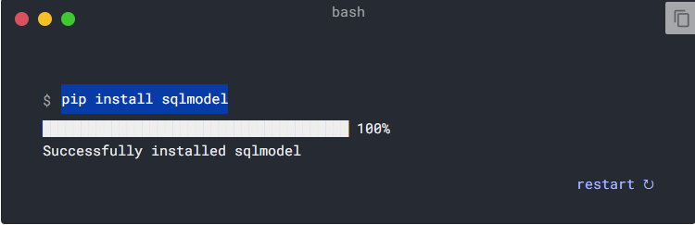
Installation
pip install sqlmodel

Slide 5
Creating a connection to a database.
from sqlmodel import SQLModel, create_engine
connection_string = "sqlite:///database.db"
engine = create_engine( connection_string )
SQLModel.metadata.create_all(engine)
A connection string is a string that specifies information about a data source and the means of connecting to it.

Slide 6
Creating a connection to a database.
username = 'postgres'
password = 'root'
host = 'localhost'
port = '5432'
database_name = 'postgres'
connection_string = f'postgresql://{username}:{password}@{host}:{port}/{database_name}'

Slide 7
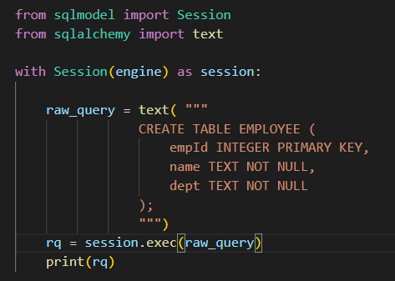
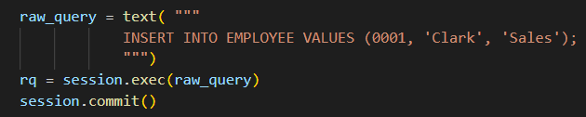
Raw query

Slide 8
What is Object-Relational Mapping (ORM)?
Object-relational mapping (ORM) is the process of abstracting the connection between programming language entities (objects) and their corresponding database elements.
Object-relational mapping is a software layer that translates object data to the underlying database, abstracting database details from the programmer. That way, the code remains unchanged even if the underlying databases are swapped out with new or different designs. Object-relational mapping allows for the creation of modular applications that are easy to manage and maintain.
https://aws.amazon.com/what-is/object-relational-mapping/

Slide 9
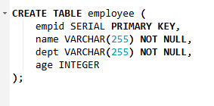
Database to Code (ORMs)
from sqlmodel import Field, SQLModel
class Employee(SQLModel, table=True):
empid: int | None = Field(default=None, primary_key=True)
name: str
dept: str
age: int | None = None

Slide 10

Inserting Data
from sqlmodel import Session
emp1 = Employee( name='Clark', dept='Sales')
emp2 = Employee( name='Dave', dept='Accounting')
emp3 = Employee( name='Ava', dept='Sales’)
with Session(engine) as session:
session.add(emp1)
session.add(emp2)
session.add(emp3)
session.commit()

Slide 11

Reading Data
from sqlmodel import Session, select
with Session(engine) as session:
statement = select(Employee)
results = session.exec(statement)
for emp in results:
print(emp)
print( results.all() )

Slide 12

Filtering Data (Where clause)
from sqlmodel import Session, select
with Session(engine) as session:
statement = select(Employee).where(Employee.name == “Ava")
results = session.exec(statement)
for emp in results:
print(emp)

Slide 13
Read One Row
statement = select(Employee).where(Employee.Age == None)
results = session.exec(statement).first()
statement = select(Employee).where(Employee.id == 1)
results = session.exec(statement)
print(results.first())
emp = session.get(Employee, 1)
print(emp)

Slide 14

Update Data
statement = select(Employee).where(Employee.id == 1)
emp = session.exec(statement).first()
emp.age = 16
session.add(emp)
session.commit()

Slide 15

Delete Data
statement = select(Employee).where(Employee.id == 1)
emp = session.exec(statement).first()
session.delete(emp)
session.commit()

Slide 16
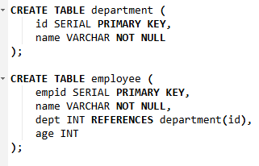
Foreign Keys
class Employee(SQLModel, table=True):
empid: int | None = Field(default=None, primary_key=True)
name: str
dept: int | None = Field(default=None, foreign_key="department.id")
age: int | None = None
class Department(SQLModel, table=True):
id: int | None = Field(default=None, primary_key=True)
name: str

Slide 17

Joins
with Session(engine) as session:
statement = select(Employee, Department).join(Department)
results = session.exec(statement)
for x in results:
print(x)

Slide 18
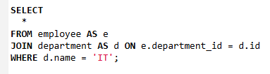
Joins + Filter
with Session(engine) as session:
statement = select(Employee, Department).join(Department).where(Department.name == "IT")
results = session.exec(statement)
for x in results:
print(x)

Slide 19
Simple Code Structure
─ project
── __init__.py
── app.py
── database.py
── models.py

Slide 20
Database.py
from sqlmodel import SQLModel, create_engine
sqlite_file_name = "database.db"
sqlite_url = f"sqlite:///{sqlite_file_name}"
engine = create_engine(sqlite_url)
def create_db_and_tables():
SQLModel.metadata.create_all(engine)

Slide 21
models.py
from sqlmodel import Field , SQLModel
class Employee(SQLModel, table=True):
empid: int | None = Field(default=None, primary_key=True)
name: str
dept: str
age: int | None = None

Slide 22
app.py
from sqlmodel import Session , select
from database import create_db_and_tables, engine
from models import Employee
def main():
create_db_and_tables()
# what you want to do here
if __name__ == "__main__":
main()

